Slide 1
Human Resources Application
CAMPOLINA​

Slide 2


Agenda
A
Problem Statement
Objectives
Project Introduction
Live Demonstration
Future Improvement

Slide 3
Problem Statement
P
1. Inefficient Interview Scheduling
Inefficient interview scheduling causes difficulties in setting interview times, managing availability, and handling scheduling conflicts, leading to delays in the recruitment process.
2. Limited Job Posting Reach
The absence of a centralized platform for job posting limits the ability to access qualified candidates through various channels, making it difficult to recruit effectively.
3. Disorganized Applicant Tracking
Using manual methods to keep track of applicant information, such as resumes and application status, leads to disorganization, inefficiency, and makes it harder to shortlist and evaluate candidates.
4. Unsatisfactory candidate experience
The present recruitment process suffers from a lack of user-friendly interface, timely communication, and personalized feedback, leading to a negative experience for candidates and a decline in employer branding.

Slide 4
Objectives
Increase Efficiency and Productivity
Streamline Recruitment Process
Enhance Applicant Experience
Increase HR efficiency and productivity by automating manual tasks, optimizing workflows, and centralizing recruitment activities in a single platform.
Implement a system that streamlines the recruitment process, from job posting to candidate selection, to improve efficiency and reduce time-to-hire.
Provide a positive and engaging experience for applicants throughout the recruitment journey, ensuring smooth communication and timely feedback.

Slide 5
Project Introduction
Implement integrated scheduling features to streamline interview scheduling, coordinate availability, and reduce scheduling conflicts and delays.
Enable HR personnel to create, customize, and publish job postings across various channels to attract a diverse pool of qualified candidates.
Allow HR professionals to track and manage all applicant data, including resumes and application status, to streamline the screening and shortlisting process.
Enhance the overall candidate experience by providing a user-friendly interface, timely communication, and personalized feedback to foster positive impressions of the organization and strengthen employer branding.

Slide 6
Back End
Front End
HTML
SCSS
Angular Version 17
Database: MySQL
Java
Spring Boot

Slide 7
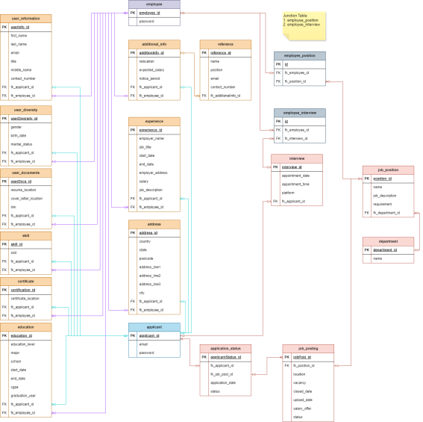
ERD

Slide 8
Live Demonstration
Human Resources App

Slide 9
Future Improvement
Collaboration and Communication
Integration with Social Media Platforms
Facilitate seamless communication and collaboration between HR personnel, hiring managers, and candidates through integrated communication channels and collaboration tools such as messaging, email notifications, and interview feedback mechanisms.
Integrate the app with popular social media platforms to allow users to share job vacancies with their networks, increasing the reach and visibility of job postings.

Slide 10
Thank you

